Slide 1
Shop by image
PicShop
Ayman Yachaoui
Sabrine Lazrak
Soumaya Haj Youssef
Yu Tian

Slide 2
Market Study
From Picture to Order
Growth of shoes sales according to Xerfi-Precepta study
1,5
0%
8
8
1,0
2
Sabrine
PicShop
Notes:
http://www.lsa-conso.fr/l-e-commerce-moteur-des-ventes-de-chaussures-selon-l-etude-xerfi,142551Xerfi is a private institute of Economical Studies specialized in the analysis of sectors and companies.
The group Xerfi publish each year hundreds of studies on the various business areas of industry, services, retail and finance, French and internationally.

Slide 3
Recommendation applications
From Picture to Order
How many users for recommendation Websites/app?
3
PicShop
Sabrine

Slide 4
Customer behavior
From Picture to Order
When you want to buy a specific product and you don’t find it in the Store :
4
Sabrine
PicShop
Notes:
When you want to buy a spe

Slide 5
Customer behavior
From Picture to Order
People who wanted to buy a product without knowing the name:
5
Sabrine
PicShop
Notes:
When you want to buy a spe

Slide 6
Using our application
From Picture to Order
Will people use our application?
5
Sabrine
PicShop
Notes:
When you want to buy a spe

Slide 7
7
Soumaya

Slide 8
PicShop, How does it work ?
From Picture to Order
When the customers buys the item he’s interested in, PicShop gets a fee of the transaction
PicShop algorithm matches the shoe with it’s indexed database
PicShop redirects the user to websites where the shoe is on sale
The User takes a picture of the shoe he’s interested in
8
Soumaya
PicShop

Slide 9
The PicShop Algorithm
Deep Learning capabilities to find recognize items
S
SPECIFIC
Start with data of sold shoes on vendors’ website. These vendors offer API’s to their databases and are free to use. Exp > Amazon Product Advertising API
M
MEASURABLE
Data acquired is used to train machine learning models for Feature Detection (PCA-SIFT), Color detection(Piximilar Multicolor),Shape, Texture and text (Convolutional Neural Networks)
A
ATTAINABLE
These algorithms are « easily » implemented using deep learning frameworks like Google TensorFlow or Theano
R
RELEVANT
Algorithm tuning is possible and allows better precision on domain-specific images (shoes for example)
T
TIME-BOUND
The user’s request is quickly solved since the algorithm training is done previously and the matching only takes few seconds even on large datasets of pictures.
Ayman
PicShop

Slide 10
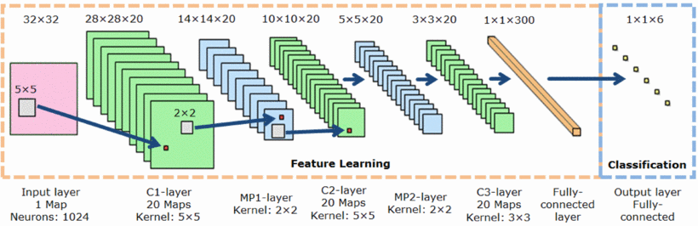

The PicShop Algorithm, Design Steps
How do we plan to set the technology in place
The learnt model can be updated
The learnt model is used for forecasting
what kind of shoes new pictures are of
4
If needed, the model can be enhanced either by new data input or different layers architecture for better precision
For every new picture that is taken by the users, the neural network calculates features and classifies in the most probable kind.
3
Learning from pictures and labels
2
For every product extracted, the neural convolutional network will extract features that distinguish every class of shoes for the purpose of classifying
(Image, Product label acquisition)
Amazon and other vendors provide APIs for a free, unlimited data acquisition
1
PicShop
Ayman

Slide 11
The PicShop Algorithm, Output
What is the output of the algorithm ?
Highest probability class, the most likely
Lowest probability class, unlikely
Shoe class w
Shoe class z
Shoe class y
Shoe class x
PicShop
Ayman

Slide 12
PicShop Algorithm, Proof of concept
They say a demo is worth a thousand pitches
Choose randomly a particular animal race
Provide us with a picture of it, from Google or elsewhere
The algorithm will classify your picture into on of the animal races it learned
You’re convinced !
A beta version of the picshop algorithm have been trained by us to recognize animals
PicShop
Ayman

Slide 13
Our competitors ‘ Business Model
How companies like ours operate > Pounce and CamFind, ...
E
D
C
B
A
A
The company works with retailer partners and third parties to build up its product database, linking item photos to inventory and pricing information
B
Shoppers aren’t buying from Pounce, but are purchasing directly from the retailer, via the application, at the same price as in the retailer’s website.
C
Pounce can only recognize items that are printed in paperback fliers or on some sort of printed material for adverstising purposes
D
Pounce offers deals browser, which lets user compare ongoing promotions from all retailers > puts them in competition with other shopping deal finders
E
The company, a team of five full-time, is backed by an undisclosed seed round of financing from local angel investors and capital venturers
CamFind > http://camfindapp.com/
Pouce > https://techcrunch.com/2013/11/12/pounce-the-app-that-helps-shoppers-find-items-using-image-recognition-is-now-a-deals-browser-too/
PicShop
Ayman

Slide 14



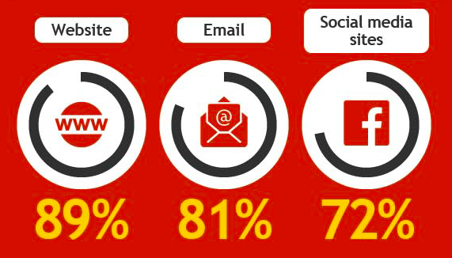
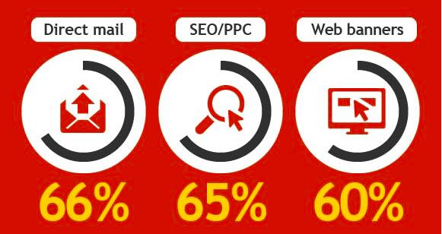
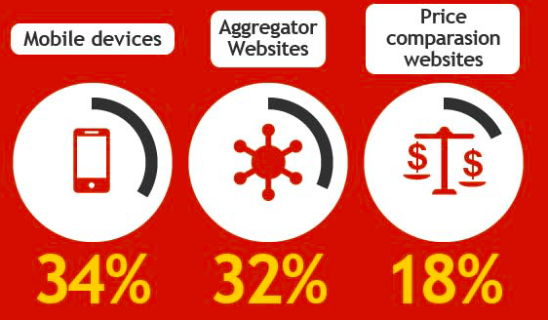
Most Effective Digital Marketing Tools for customer acquisition
From Picture to Order
How to attract new customers ?
11
Soumaya
PicShop
Notes:
http://www.cleverbridge.com/corporate/ecommerce-eye-candy-customer-acquisition-vs-retention-costs-infographic/
Social media : Les réseaux sociaux doivent être intégrés comme une part importante de votre stratégie de promotion! Créez une page (Twitter et Facebook) spécialement dédiée à votre application. Elle aura pour effet de vous construire une communauté, donner des informations importantes (tels que les bugs, les mises à jours,…) et recueillir les impressions de vos clients. Cette page doit devenir un véritable lieu d’interaction et d’échange ! De plus, n’hésitez pas à faire de la publicité payante sur Facebook qui propose des ciblages précis.
Email :

Slide 15
Cost Structure of the 1st Stage
The first stage lasts for 3 months during which we will develop our product and marketing within France
Up-front investment of developing the prototype product: 5,000 EUR/month.
Our promotion is web-based. The Click-to-download rate is usually 0.2 EUR per download. The appearance-based pricing plan is also adopted in our promotion.
The server maintenance fee is based on the number of active user we have. It is marginal decreasing. We estimate it to be 1,000 EUR/month
Fund raising: Crowd Funding and Venture Capital Funding
12
Yu Tian

Slide 16
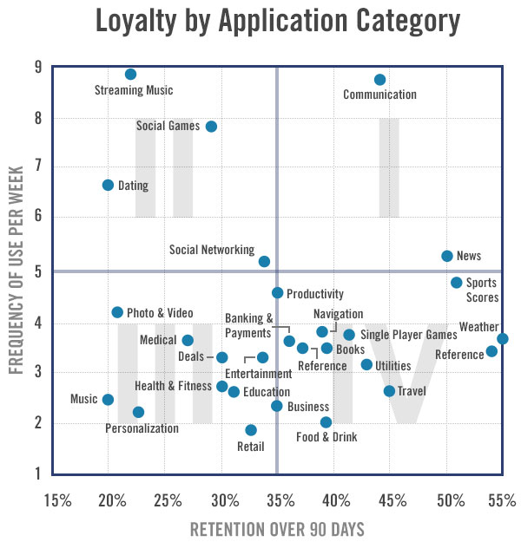
Estimation of Active Users
An active user is defined as using the app once every ten days.
A definition adopted by most ecommerce website is twice a week. But our product is focus only on shoes-shopping, three times a month is a reasonable threshold.
Yu Tian
13

Slide 17
Expected Number of Active Users
According to the data provided by etao.com (a price-comparison-and-recommendation website of Alibaba), 3% of the searches will turn to orders.
But each user conduct 2.5 searches per visit.
So the possibility to buy each visit is 7.5% percent.
14
Yu Tian

Slide 18
Expected Revenue per Month
Most Websites offers a flat rate between 4~20% of the value of the order.
Some websites offers volume-based marginal increasing model.
By using a specific model. We combine the two type of affiliation to optimize our profit.
15
Yu Tian

Slide 19
How the revenue is estimated?
Each shoe order cost the consumer 58.3 EUR.
Calculated by using the data provided by etao.com, the information shoes price in French market and a simple price/consumption model.)
Assume the rate of redirection fee is 5% of the order.
Around 2.9 EUR return on average each order.
Based on the model of active users, the estimated revenue of 9,000 per month in the first stage.
16
Yu Tian

Slide 20
Expected Profit per Month
Profit = Revenue - Cost
17
Yu Tian

Slide 21
Future stages
Second stage: European market and wider range of consumer (different age groups)
Estimated No. of users: 20,000 (doubling the number of users in the first stage)
Length of Six months.
Estimated profit per month: 60,000 EUR per month.
Third stage: Wider range of item recognition and world wide market.
Length of 18 months
Estimated number of active users: 1,000,000
Company goal is to increase the number of users, building world-wide market, not increase revenue. There will be a drastic change comparing with the second stage in the management of the company.
Forth stage: Enhancement of the earning performance.
A long and steady stage.
With the market share and user base. The company will turn attention from marketing to earning.
18
Yu Tian

Slide 22
Valuation Estimation
The evaluation is user-and-revenue-flow based.
A Price-Earning ratio of 5 is adopted. It is rather modest and reasonable for an IT company.
19
Yu Tian

Slide 23
Thank you for your attention

